Slide 1


Churn Analysis Report
Omnistique
Data Analysis Unit
Ritik Agrawal-OM2301

Slide 2
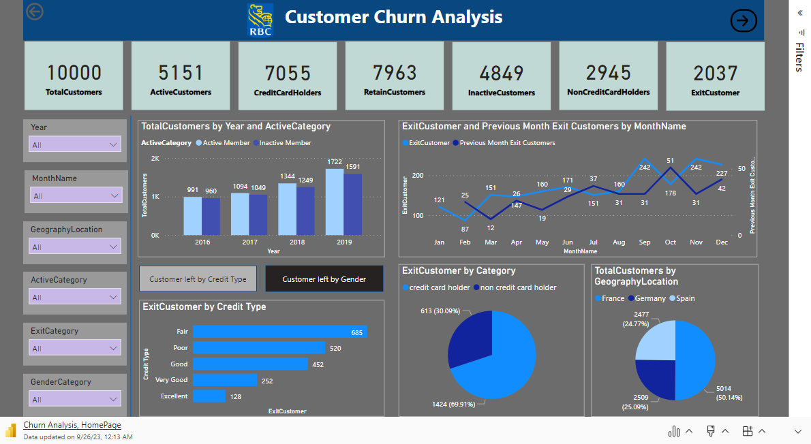

Slide 3
Churn Analysis - Highlights
Customers having fair credit score are more likely to be exit customer result in increase in Churn.
Exit Customer and total Previous Month Exit Customers are positively correlated with each other.
Active members(5151) are higher than inactive members(4849).
Customers holding credit card exit more than customers not having credit card.
France accounted for 50.14% of Total Customers.
Exit of Male (44.08%) is less than exit of Female (55.92%).
Customers having more than 2 no. of product are less likely to be churn.
More or less Customers having maximum tenure of 4 years

Slide 4
Customers holding credit card is more than for those owing no. of product upto 2 .
Total Churn is 20.37%.

Slide 5
Recommendations
To stop the churn of Fair & poor credit type, provide customer support , credit counselling, loyalty programs , flexible payment option.
For credit card holders churn , provide customers with loyalty programs including schemes, discount , bouchers, Low Introductory APR(Annual percentage Rates), provide educational resources to make their credit score better.
To reduce female churn , provide female customers with exclusive customer support, develop female centric products, create female –focused marketing campaign.
In short, enhance customer feedback system, run loyalty programs including discounts ,schemes to providing more benefits for long term customers, make programs to provide education resources to handle their credit more, give competitive offers , and enhance customer support system and simplify redeem system.

Slide 6
Thank You

